Slide 1
By : Abhishek Choudhary
Under Guidance of Prof. Jhareswar Maiti
Title - Intelligent recommendation system using LLMs for process
safety improvement

Slide 2
Introduction
Safety is crucial in benzene plants due to the High risks associated with its flammability, toxicity and environmental impact
Our dataset offers insights with Node and it’s deviations encountered during operations, including causes, consequences, and risk in Benzene Plant
Our aim is using advanced technologies to generate recommendations aimed at minimizing the risk in benzene manufacturing plant

Slide 3
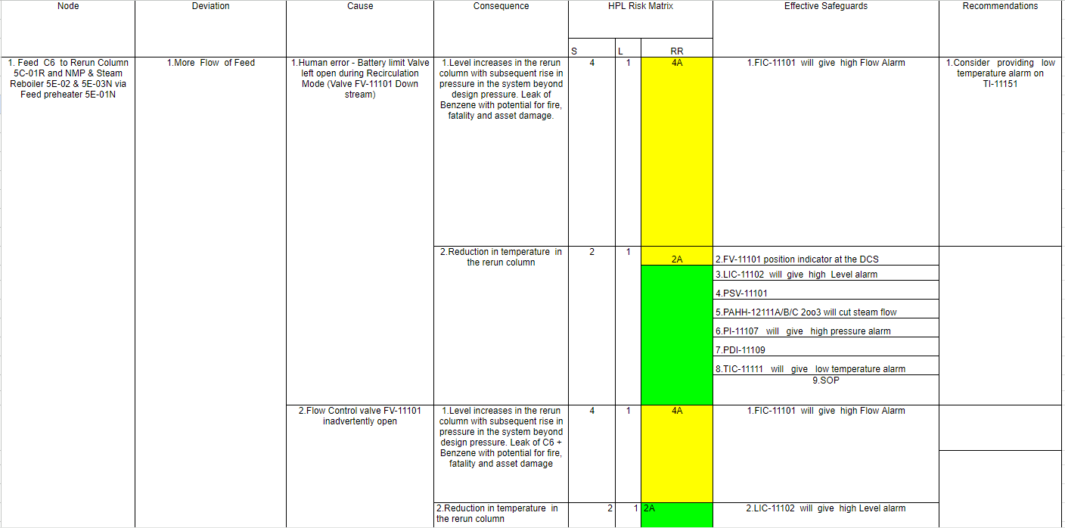
Introduction
Overview of our dataset -

Slide 4
Literature Review
The majority of accident domain literature primarily relies on numerical or categorical data for analyzing accident scenarios.
Yet, the exploration of free-text data, such as descriptive information, is often overlooked due to the challenging nature of extracting patterns from unstructured passages.
Narrative text stands out as a crucial resource for predicting accident risk levels, offering valuable supplementary insights alongside other data types in the analysis.

Slide 5
Objectives
Develop recommendations based on the dataset of benzene processing facilities using llm model architectures
Utilize feature selection and input prompt techniques to enhance recommendation accuracy
Integrate safety engineering principles to ensure alignment with industry standards in recommendation generation
Implement a robust evaluation framework, including rouge matrix analysis, for selecting optimal safety recommendation models.

Slide 6
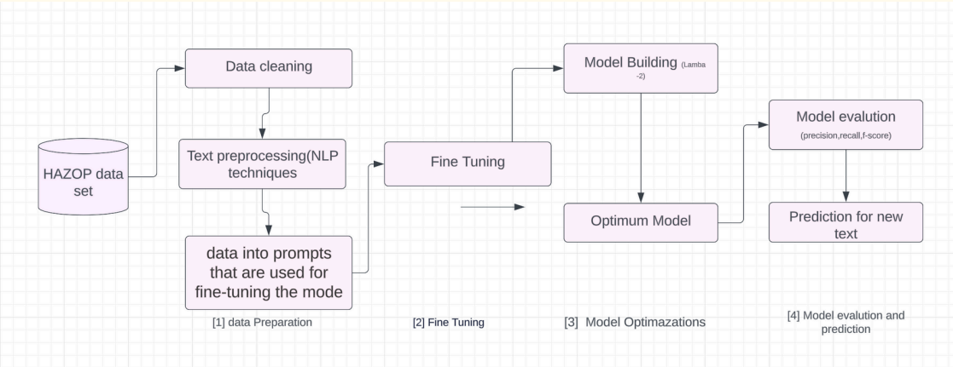
Methodology

Slide 7
Methodology
Step 1: Importing our dataset
Step 2: Data preprocessing which includes data cleaning and data formatting
Step 3: Perform text preprocessing using NLP techniques such as tokenization, stop word removal, and stemming to clean and standardize the textual data
Step 4: Perform operations to transform our data into prompts that are used for fine-tuning the model. There are different format of input prompt of different models

Slide 8
Methodology
Step 5: Select a suitable LLM model architecture for the seq-to-seq task based on the specific requirements and objectives of the project
There are three types of llm model architectures -
Encoder based like Bert
Decoder based like gpt, llama, Mixtral
Encoder + Decoder based like Bart
For generative task there must be decoder component so we can use both Decoder and Encoder + Decoder architectures for the project

Slide 9
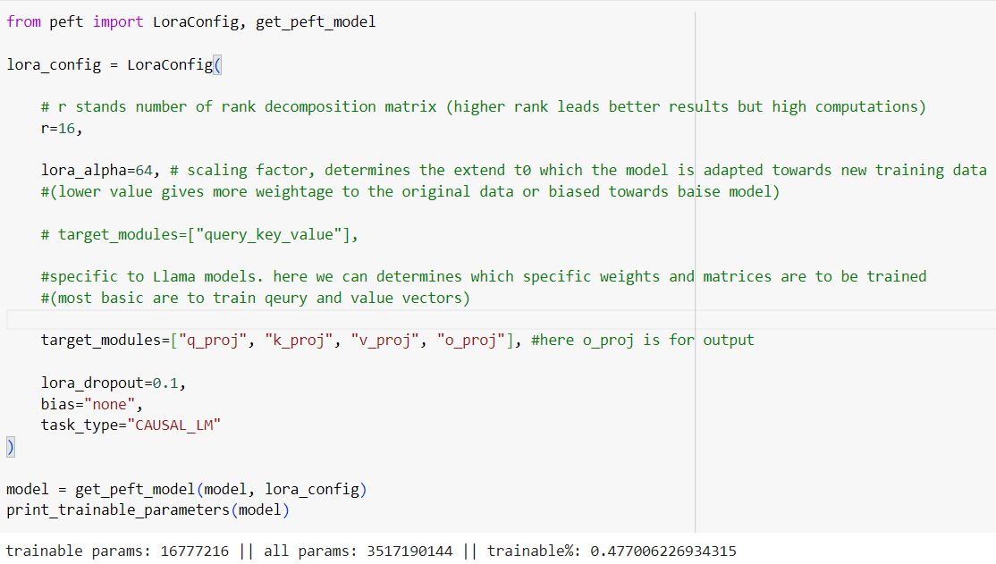
Methodology
Step 6: Fine-tune the selected LLM models
We are using Google colab which
only provide 15 gb GPU for limited
time, so it is impossible to train all
parameters. We can use qlora or lora
configuration to fine tune model on
local system with limited gpu.

Slide 10
Methodology
Step 7: Evaluate the performance of fine tuned llm model using rouge matrix for every model applied, trying to maximize the accuracy for predicting recommendations
The input prompt is like -
Question=”what is the recommendation when Deviation: {1. Deviation} in a Node: {2. Node}?
context=”Due to deviation {1. Deviation} in the {2.Node}, the cause is {3. cause}, the consequence is {4. consequence} and Effective safeguard is {5. Effective safeguard }
Answer = {6. Recommendations}

Slide 11
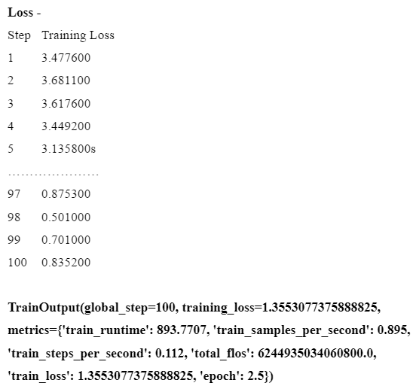
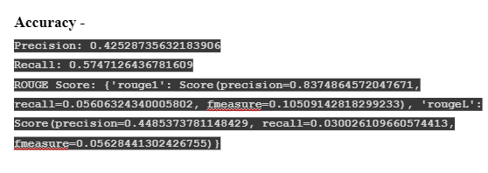
Llama 2 -

Slide 12
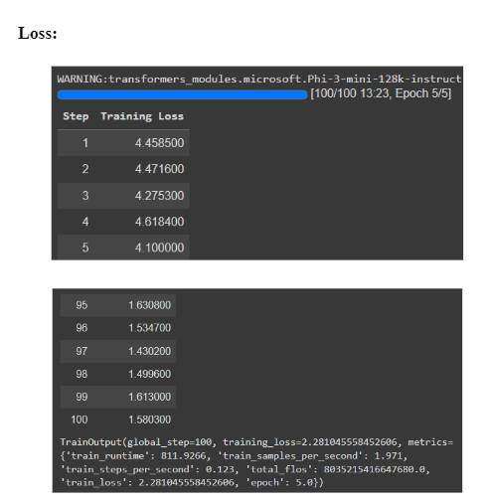
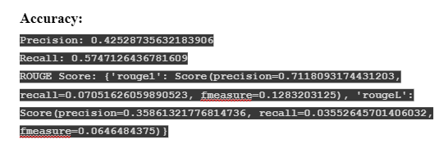
Phi 3 -

Slide 13
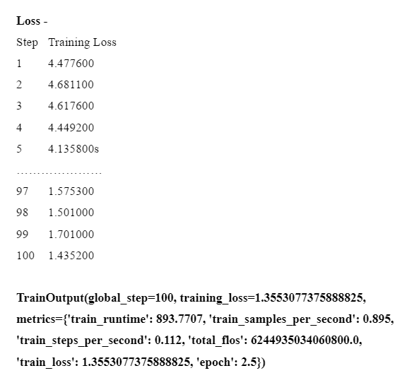
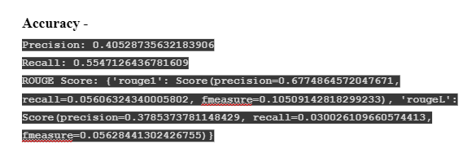
Bart -

Slide 14
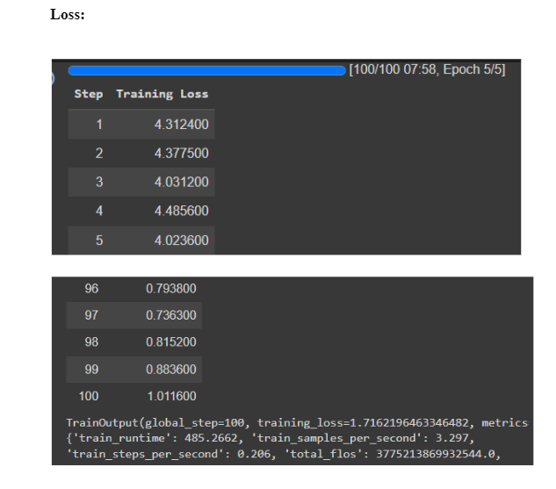
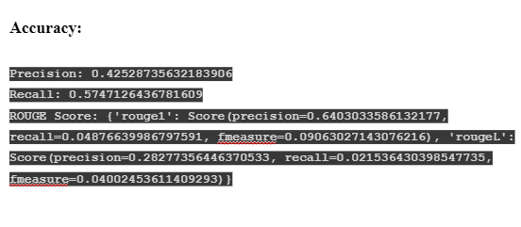
Gemma -

Slide 15
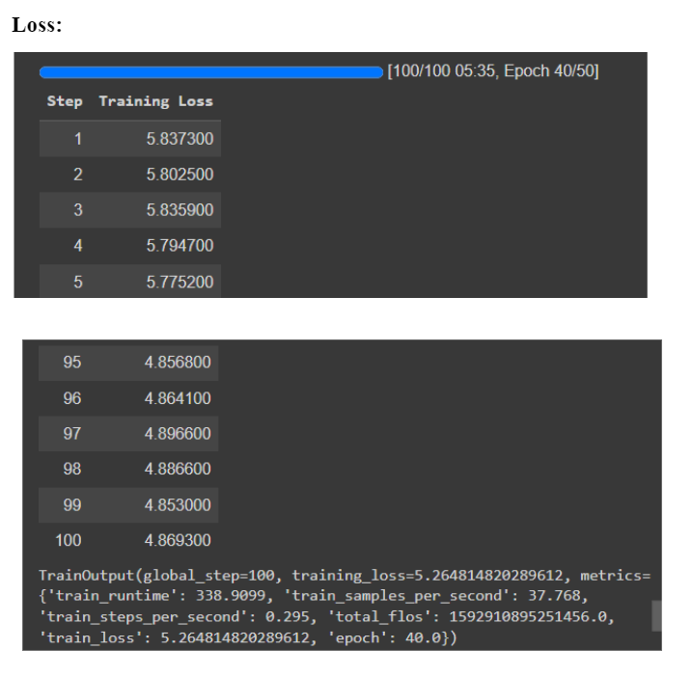
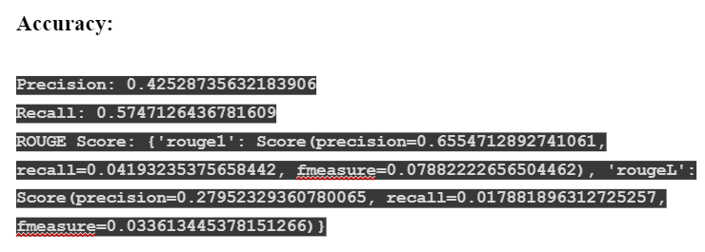
Results
GPT 2 -

Slide 16
Results
Model | Rouge 1 (precision) | Rouge L (precision)
LLama 2 | 0.84 | 0.45
Phi 3 | 0.71 | 0.36
Bart | 0.68 | 0.34
Gemma | 0.64 | 0.29
GPT 2 | 0.65 | 0.27

Slide 17
Conclusion
Our study showcases the effectiveness of fine-tuning advanced language models (LLMs) for Generation tasks within Hazop industries
Utilizing advanced LLMs like Llama-2 allows for more accurate risk assessment and safety recommendations, due to their expertise in handling different language tasks
By thoroughly assessing metrics such as precision, and recall, we gain valuable insights into how well fine-tuned models predict
Combining fine-tuned LLMs with traditional methods innovatively strengthens predictive models, improving workplace safety and reducing industrial risks in industries

Slide 18
References
Llama 2: Open foundation and fine-tuned chat models
[1706.03762] Attention Is All You Need
LoRA: Low-Rank Adaptation of Large Language Models
[2305.14314] QLoRA: Efficient Finetuning of Quantized LLMs
Parameter-Efficient Fine-Tuning Methods for Pretrained ..
[2401.04088] Mixtral of Experts
BART: Denoising Sequence-to-Sequence Pre-training

Slide 19
Thank you !

